Slide 1
Uses of the Infinitive in Greek
Prof. Vanessa Gorman
University of Nebraska-Lincoln
vgorman1@unl.edu

Slide 2
Infinitives
A type of verbal noun [to see, to be seen, to have seen, to seem]
As a verb:
Derive from a verb form
Tense and voice
Necessary arguments and optional adjuncts/satellites
The subject of an infinitive is expressed in the ACCUSATIVE
As a noun
They fill any syntactic role that a noun could fill
They may be modified by a neuter singular article [ARTICULAR INFINITIVE]
Negated by μή (except in indirect speech)
Made potential by ἄν

Slide 3
Complementary Infinitives

Slide 4
Complementary Infinitive [dynamic]
Necessary to complete the meaning of the verb
Negated by μή
With modals, verbs of knowing, intending, wishing, ordering, being able, forcing, learning, etc. [κελεύω is very common]
Infinitive clause is the OBJ of the introductory verb
It does not usually have its own subject

Slide 5
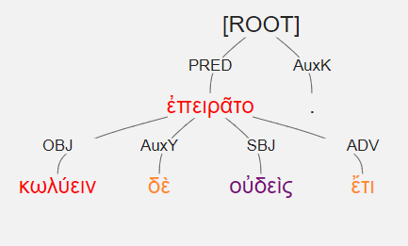
κωλύειν δὲ οὐδεὶς ἔτι ἐπειρᾶτο. [3.2.26]
And still no one tried to prevent it.

Slide 6
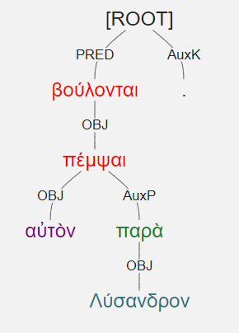
βούλονται αὐτὸν πέμψαι παρὰ Λύσανδρον. [2.2.16]
They want to send him to Lysander.

Slide 7
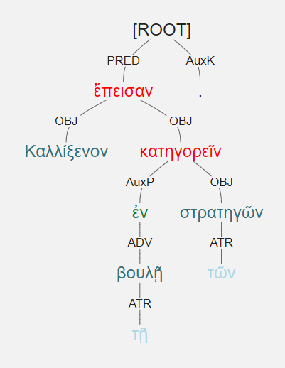
Καλλίξενον ἔπεισαν ἐν τῇ βουλῇ κατηγορεῖν τῶν στρατηγῶν. [1.7.8]
They persuaded Kallixenos to lay charges against the generals in the Council.

Slide 8
Impersonal Constructions
The infinitive clause acts as the SBJ

Slide 9
Impersonal Constructions
It is necessary to do something; it is possible; it is clear; it is a care to me; it is shameful; it is difficult, etc.
Common introductory verbs:
δεῖ [It is necessary]
χρή [It is necessary]
ἔξεστι [It is possible]
ἐστιν + neuter nom sg [δῆλον; χαλεπόν; etc.]
Infinitive = SBJ
Often takes a dative OBJ [similar to a dative of reference]

Slide 10
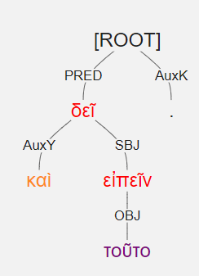
καὶ τοῦτο δεῖ εἰπεῖν. [2.4.27]
And it is necessary to say this.

Slide 11
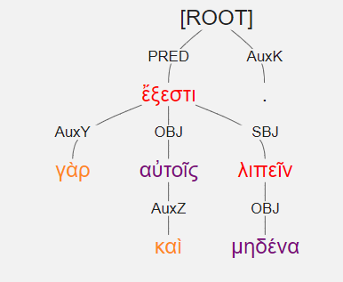
ἔξεστι γὰρ αὐτοῖς καὶ μηδένα λιπεῖν. [2.3.41]
For it was possible even for them to leave no one.

Slide 12
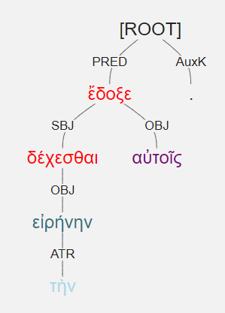
ἔδοξε δέχεσθαι αὐτοῖς τὴν εἰρήνην. [2.2.22]
It seemed best to them to accept the peace.

Slide 13
Indirect Statements

Slide 14
Indirect Statements [declarative]
With verbs of saying, thinking, believing, opining
Infinitive acts as OBJ
It often has a SBJ in the accusative
If the subject is not expressed, it is usually the speaker.
Negated by οὐ
Commonly introduced by:
φημί [say]
λέγω [say]
οἶδα [know] [irregular perf as pres: I have seen, therefore I know]
εἴπον [said] [irregular; no present]
φάσκω [think, say]

Slide 15
Most common forms that introduce indirect speech in the Hellenika
 | Form | Freq
ἔφη | 3s aor ind act | 121
ἔφασαν | 3p impf ind act | 53
ἔλεγον | 3p impf ind act | 29
ἔλεγεν | 3s impf ind act | 15
ἔλεξεν | 3s aor ind act | 12
λέγεται | 3s pres ind MP | 11
εἶπε(v) | 3s aor ind act | 81

Slide 16
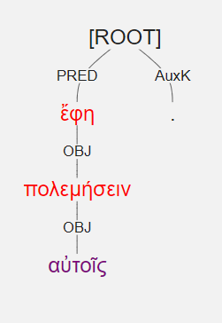
πολεμήσειν ἔφη αὐτοῖς. [1.3.3]
He said he would make war on them.
No subject, so it is probably the speaker

Slide 17
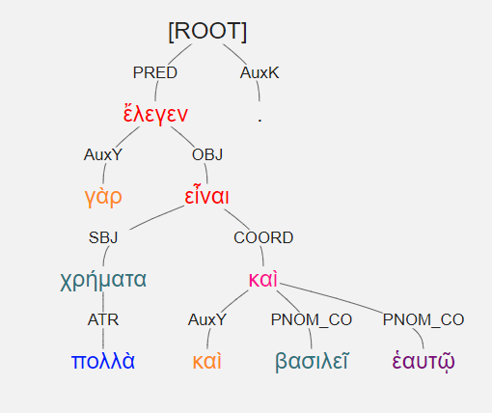
ἔλεγεν γὰρ εἶναι χρήματα πολλὰ καὶ βασιλεῖ καὶ ἑαυτῷ. [2.1.14]
For he was saying that both he and the king had much money.
Datives of Possession acting as PNOMS

Slide 18
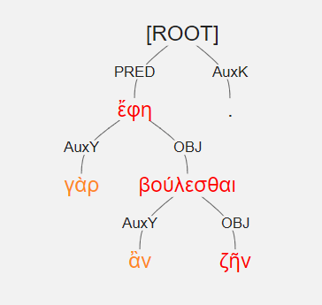
γὰρ ἂν ἔφη ζῆν βούλεσθαι. [3.1.15]
For he said that he wished to live.
Indirect speech followed by a complementary infinitive

Slide 19
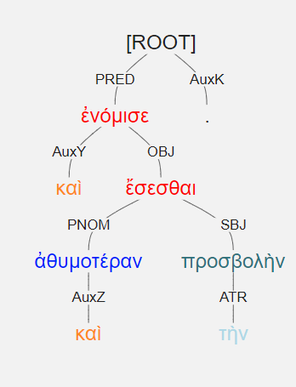
καὶ ἐνόμισε ἀθυμοτέραν καὶ τὴν προσβολὴν ἔσεσθαι. [3.1.18]
And he thought that the attack would be even more faint-hearted.

Slide 20
Result Clauses
Introduced by ὥστε

Slide 21
Result clauses
ὤστε = so that
Verb of clause = ADV
Usually after some qualitative adverb in the main clause, upon which it hangs.
οὕτω
Normally takes an infinitive
A few result clauses take the indicative to emphasize a simple, factual result.

Slide 22
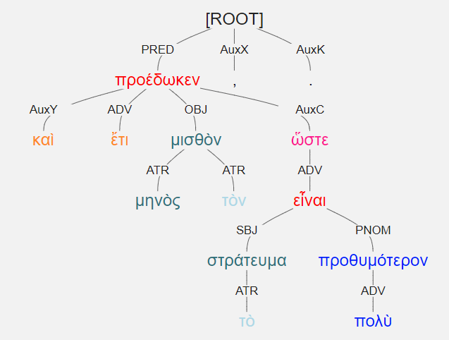
καὶ ἔτι μηνὸς τὸν μισθὸν προέδωκεν, ὥστε τὸ στράτευμα πολὺ προθυμότερον εἶναι. [1.5.7]
And he gave them pay for a month still so that the army was much more eager.

Slide 23
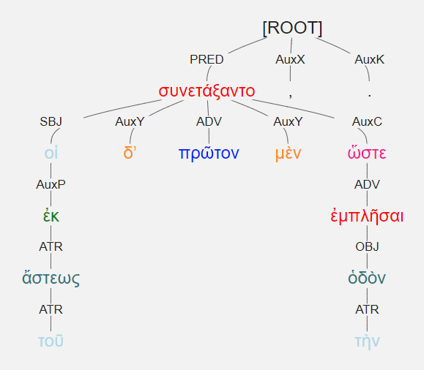
οἱ δʼ ἐκ τοῦ ἄστεως πρῶτον μὲν συνετάξαντο, ὥστε ἐμπλῆσαι τὴν ὁδὸν. [2.4.11]
The ones from the town first deployed so that they filled the road.

Slide 24
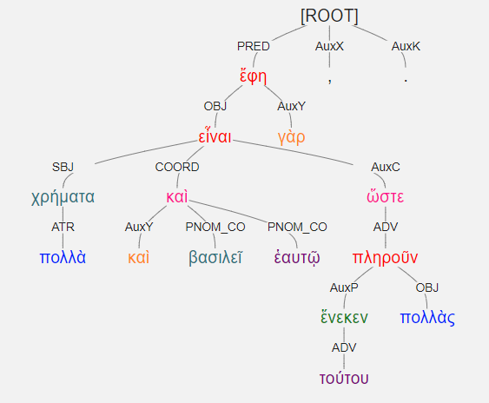
εἶναι γὰρ χρήματα πολλὰ καὶ βασιλεῖ καὶ ἑαυτῷ ἔφη, ὥστε τούτου ἕνεκεν πολλὰς πληροῦν. [2.1.14]
For he said that he and the king had a great deal of money so that because of this they could fill many [ships].

Slide 25
Substantive and Articular infinitives

Slide 26
Substantive/articular infinitives
Treat the entire infinitive clause as a noun/substantive
[Article is not necessary to make an infinitive substantive]
Use neuter singular article: τό, τοῦ, τῷ, τό
Subject of the infinitive is in the accusative
Negation is μή

Slide 27
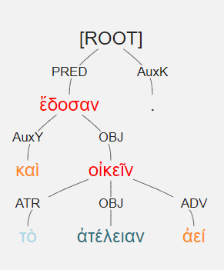
καὶ τὸ ἀτέλειαν ἀεί οἰκεῖν ἔδοσαν. [1.2.10]
And they gave them the privilege of living without taxes in perpetuity.
Literally: And they gave [them] the always living in exemption from taxes.

Slide 28
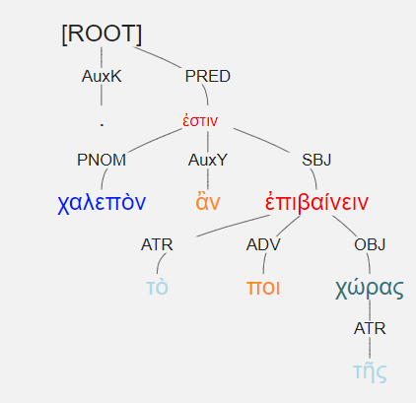
χαλεπὸν ἂν τὸ ἐπιβαίνειν ποι τῆς χώρας. [2.3.44]
Even setting foot on the land would be a difficult thing.
Supply the verb “to be” with a neuter nominative that is commonly used impersonally.
The ἄν makes it potential (“would”).

Slide 29
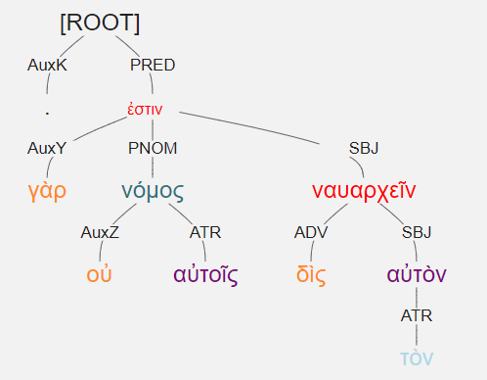
οὐ γὰρ νόμος αὐτοῖς δὶς τὸν αὐτὸν ναυαρχεῖν. [2.1.7]
For they had a law that the same man could not be naurarch twice.

Slide 30
Epexegetical infinitives
Explain things

Slide 31
Epexegetical Infinitives [explanatory]
May modify verbs to express purpose
May modify adjectives or nouns
Like the accusative of respect
Wondrous to behold; delightful to hear
Usually labelled ADV on an adjective or as ATR on a noun

Slide 32
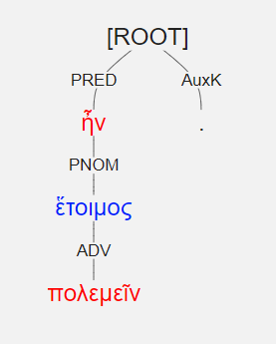
ἕτοιμος ἦν πολεμεῖν. [3.2.13]
He was prepared to go to war.

Slide 33
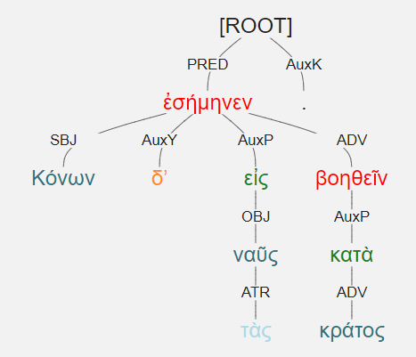
Κόνων δʼ ἐσήμηνεν εἰς τὰς ναῦς βοηθεῖν κατὰ κράτος. [2.1.28]
Konon was signaling to the ships to come help him with strength.

Slide 34
Summary of the main uses of an infinitive
Complementary [dynamic]
Impersonal Verbs
Indirect statements [declarative]
Result clauses
Articular/Substantive
Epexegetical [explanatory]

